Slide 1


Septic Shock Data Discovery Dataset
Keith R. Walley, MD
St. Paul’s Hospital
University of British Columbia
Vancouver, Canada

Slide 2
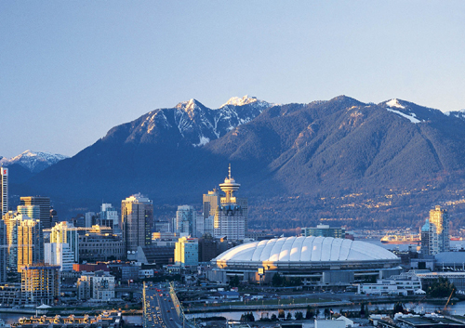
V A S S T dataset Vasopressin and Septic Shock Trial

Slide 3
Dataset arising from VASST
Septic shock is organ failure and really low blood pressure due to a severe infection.
Your body’s initial immune response to severe infection is to release many cytokines and other inflammatory mediators – which decrease blood pressure.
Low blood pressure can be increased with norepinephrine or vasopressin.
VASST hypothesis
Low dose vasopressin infusion, in addition to conventional vasopressors, will decrease 28-day mortality in human septic shock, compared to norepinephrine infusion alone.

Slide 4
1) Lots of Clinical Data >2000 fields/patient
 | Norepinephrine (n=382) | Vasopressin (n=396)
Age, years | 61.8 ±16 | 59.3 ±16.4
Male sex | 229 (59.9) | 246 (62.0)
Caucasian | 320 (83.8) | 336 (84.6)
Co-morbidities Ischemic heart disease | 65 (17.0) | 68 (17.1)
COPD | 72 (18.8) | 55 (13.9)
Chronic renal failure | 48 (12.6) | 40 (10.1)
Cancer | 104 (27.2) | 85 (21.4)
Pre-existing steroid use | 86 (22.5) | 82 (20.7)
Recent surgery | 132 (34.6) | 151 (38.0)
Time from eligibility to infusion, hrs | 11.5 ± 9.4 | 11.9 ± 8.9
Values are n (%) or mean ± SD, as appropriate

Slide 5
Plasma vasopressin levels (n = 107)
Vasopressin
Off Vasopressin
Norepinephrine

Slide 6
Kaplan-Meier survival curve All patients
Log-rank statistic
p = 0.27 day 28
p = 0.10 day 90

Slide 7
Kaplan-Meier survival curve Less severe shock
Log-rank statistic
p = 0.05 day 28
p = 0.03 day 90

Slide 8
Serious adverse events
 | Norepinephrine (n=382) | Vasopressin (n=397) | p
Myocardial infarction / ischemia | 7 (1.8) | 8 (2.0) | 1.00
Cardiac arrest | 8 (2.1) | 3 (0.8) | 0.14
Tachyarrythmia | 3 (0.8) | 4 (1.0) | 1.00
Bradyarrythmia | 3 (0.8) | 4 (1.0) | 1.00
Mesenteric ischemia | 13 (3.4) | 9 (2.3) | 0.39
Digital ischemia | 2 (0.5) | 8 (2.0) | 0.11
Cerebrovascular accident | 1 (0.3) | 1 (0.3) | 1.00
Hyponatremia | 1 (0.3) | 1 (0.3) | 1.00
Other | 2 (0.5) | 5 (1.3) | 0.45
Total | 40 (10.5) | 41 (10.3) | 1.00

Slide 9
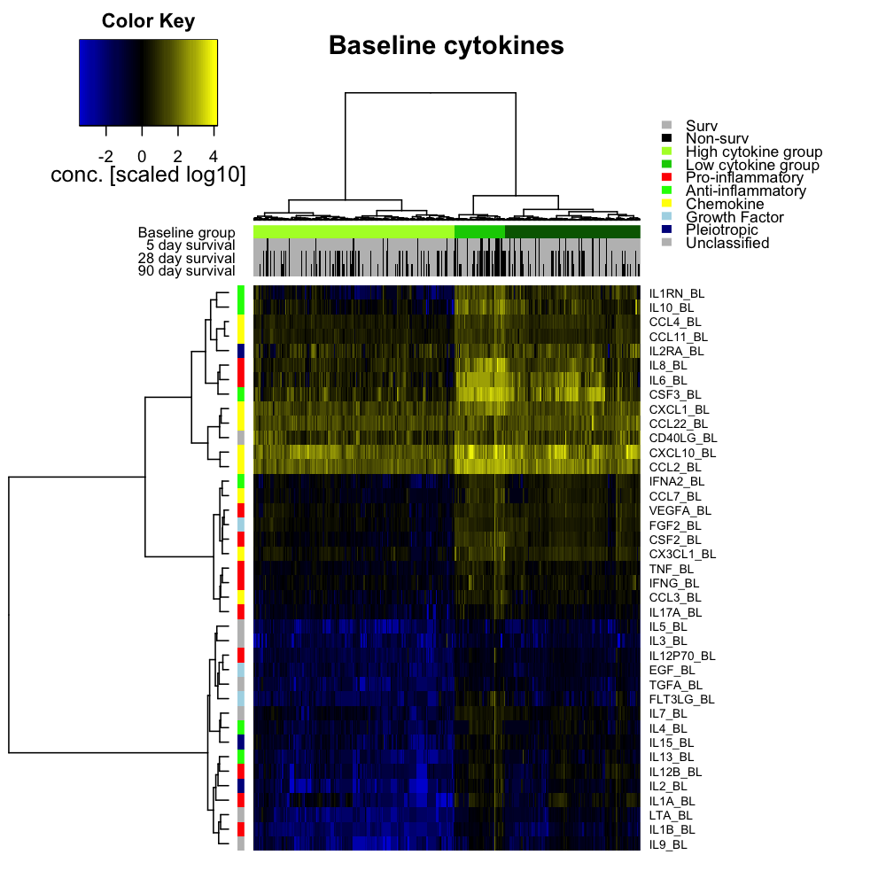
2) 50+ cytokines Russell et al. AJRCCM 2013; 188 (3): 356-364.

Slide 10
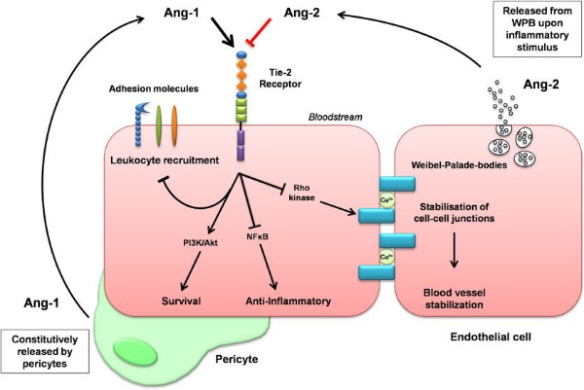

How cytokine data might be used
Hypotension
Edema
Image from www.angiopoietin.de

Slide 11
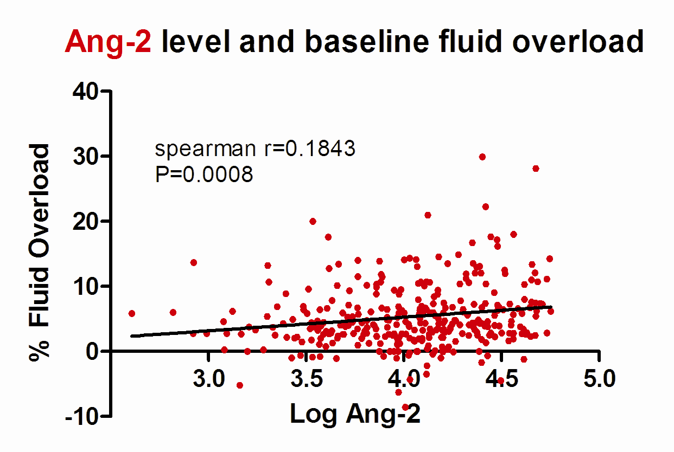
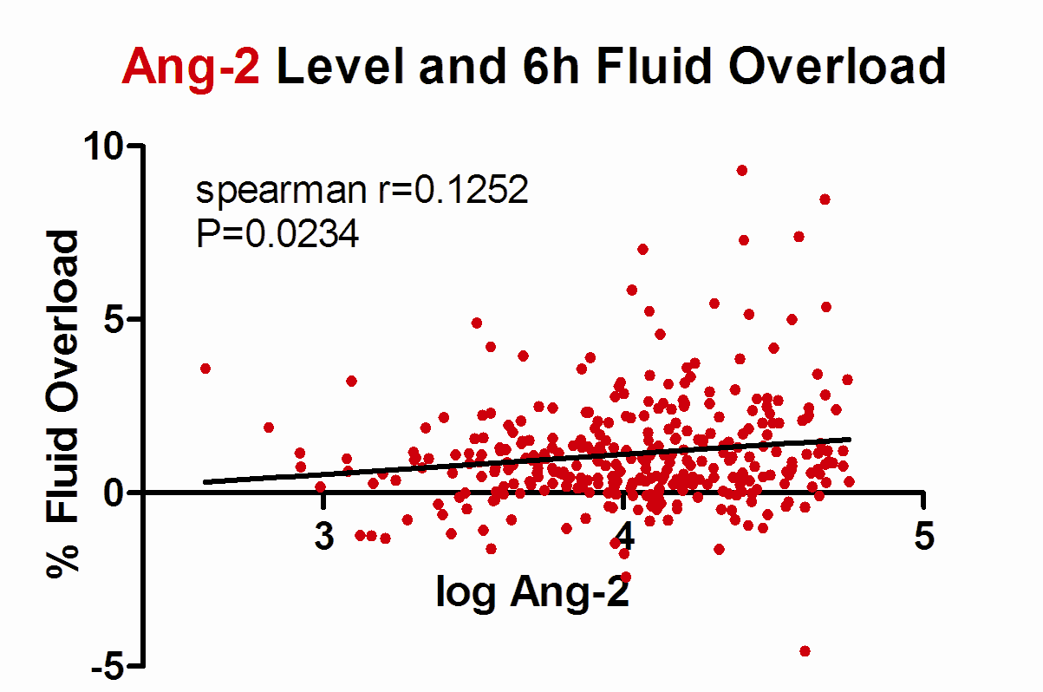
Plasma Ang-2 Levels Associated with Fluid Overload
%FO = (intake-output)/weight x 100%
Notes:
Fluid overload calculated based on the fluid intake and fluid output and body weight.

Slide 12
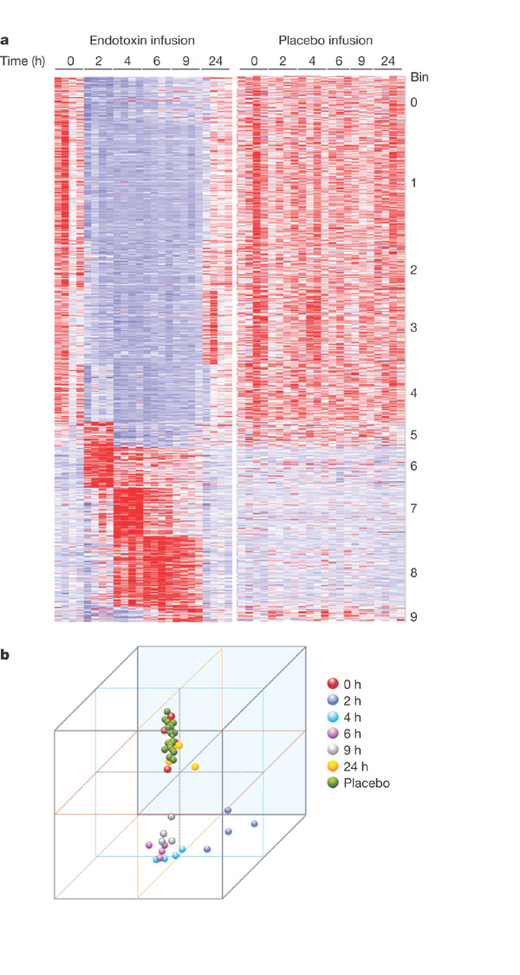
3) We don’t have gene expression (mRNA), but we have it in some datasets Calvano et al. Nature 2005;437:1032-7.

Slide 13
4) 1M Single Nucleotide Polymorphisms (SNP) genotypes
Association plot of non-synonymous SNPs with 28-day mortality

Slide 14
What can be done with the data
Clinical associations
Obesity associated with decreased survival
Gene association studies
ADRB2, AGTRAP, SVEP1, IL17, PCSK9, etc
Causal inference
Instrumental variables, Mendelian Randomization
Mechanism of action
Inhibition, over-expression
New discoveries
Link to other datasets, AI to discover patterns

Slide 15
Example clinical association

Slide 16
Example gene association
VASST
p=0.0054
SPH
p=0.022

Slide 17
Example causal inference
Unobserved alternate explanation
(Confounder)
Environment
Pollution
Smoking
Cancer
?
Exposure
Outcome

Slide 18
Instrumental Variables ➔ Cause
Unobserved alternate explanation
(Confounder)
Environment
Pollution
Tobacco tax
Smoking
Cancer
Instrument
Exposure
Outcome

Slide 19
Mendelian Randomization
Unobserved alternate explanation
(Confounder)
Environment
Genotype
Protein
Phenotype
?
Instrument
Exposure
Outcome

Slide 20
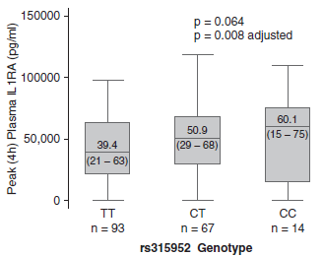
Mendelian Randomization
Environment
?
IL1RN
IL1ra
Sepsis survival
Meyer et al. Am J Respir Crit Care Med. 190(6):656-664, 2014

Slide 21
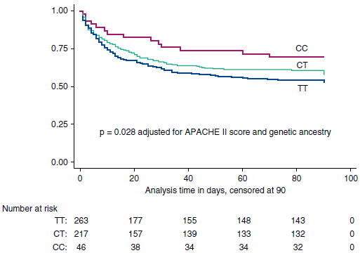
IL1RN genotype ~ Sepsis survival
Meyer et al. Am J Respir Crit Care Med. 190(6):656-664, 2014

Slide 22
Mendelian Randomization
Environment
IL1RN
IL1ra
Sepsis survival
Meyer et al. Am J Respir Crit Care Med. 190(6):656-664, 2014

Slide 23
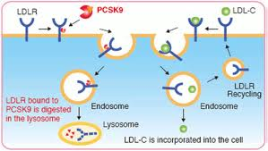
Example mechanism of action
Lipopolysaccharide
(LPS) Gram - endotoxin
Lipoteichoic acid (LTA) Gram +
Could PCSK9 inhibition increase
pathogen lipid clearance?
23

Slide 24
Pcsk9 knockout mice ↑ LPS clearance, ↓ inflammation
Walley KR et al. Science Translational Medicine. 6(258):258ra143

Slide 25
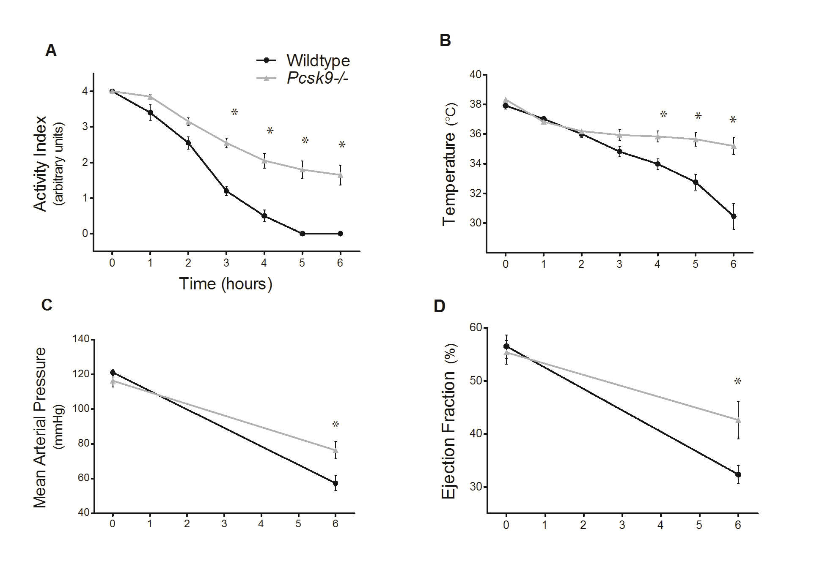
Pcsk9 knockout mice ↓ physiologic response

Slide 26
PCSK9 antibody: ↑ CLP survival
p=0.034
TNFα (p=0.027), IL-6 (p=0.051), IL-10 (p=0.068), JE (p=0.0085) and MIP-2 (p=0.040)

Slide 27
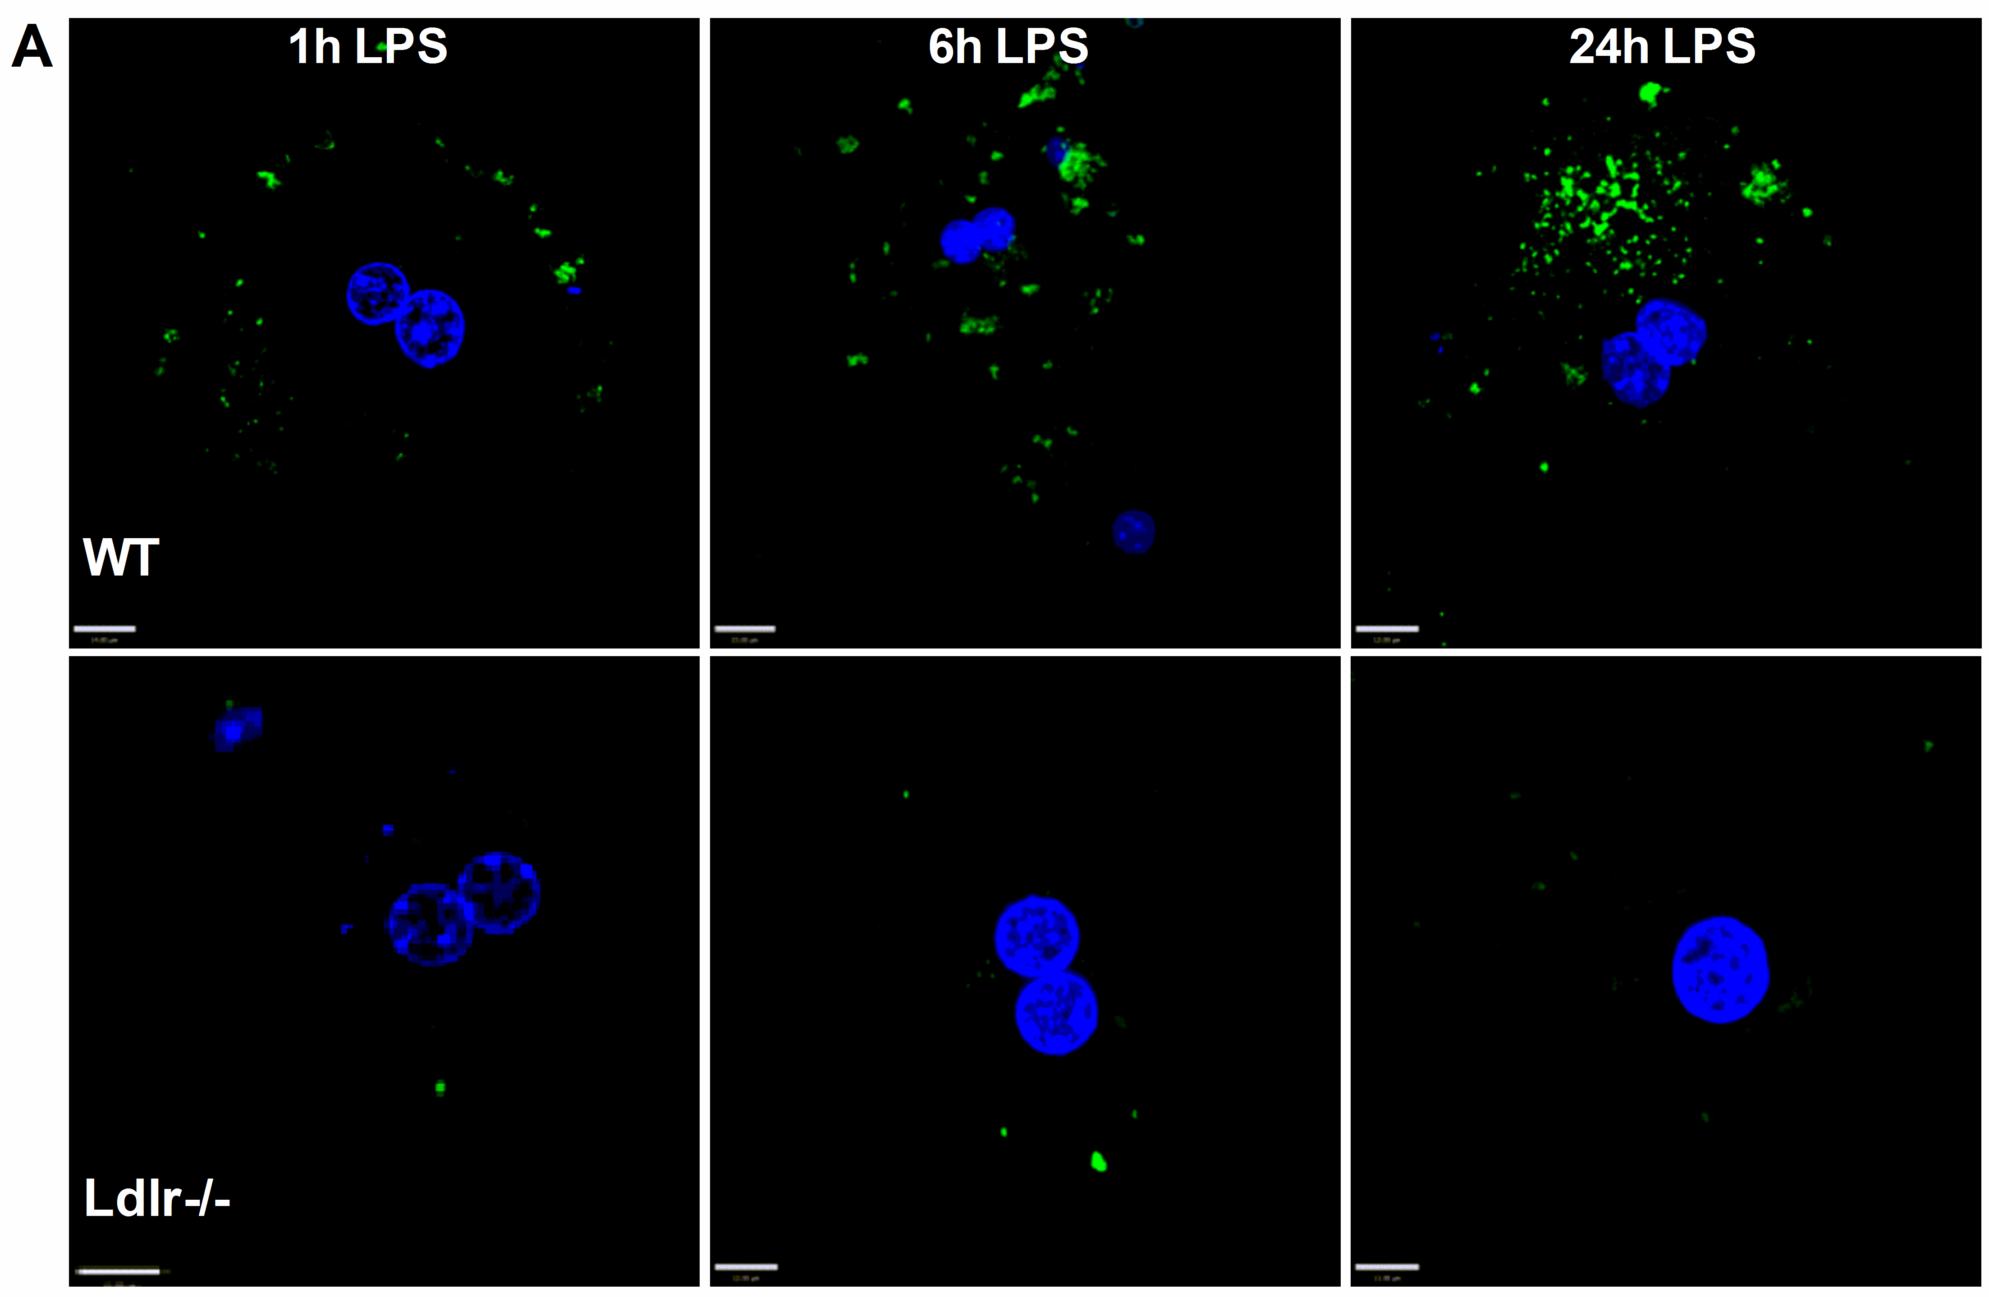
LPS uptake by hepatocytes
Topchiy E, et al. PLoS One. 2016 May 12;11(5):e0155030

Slide 28
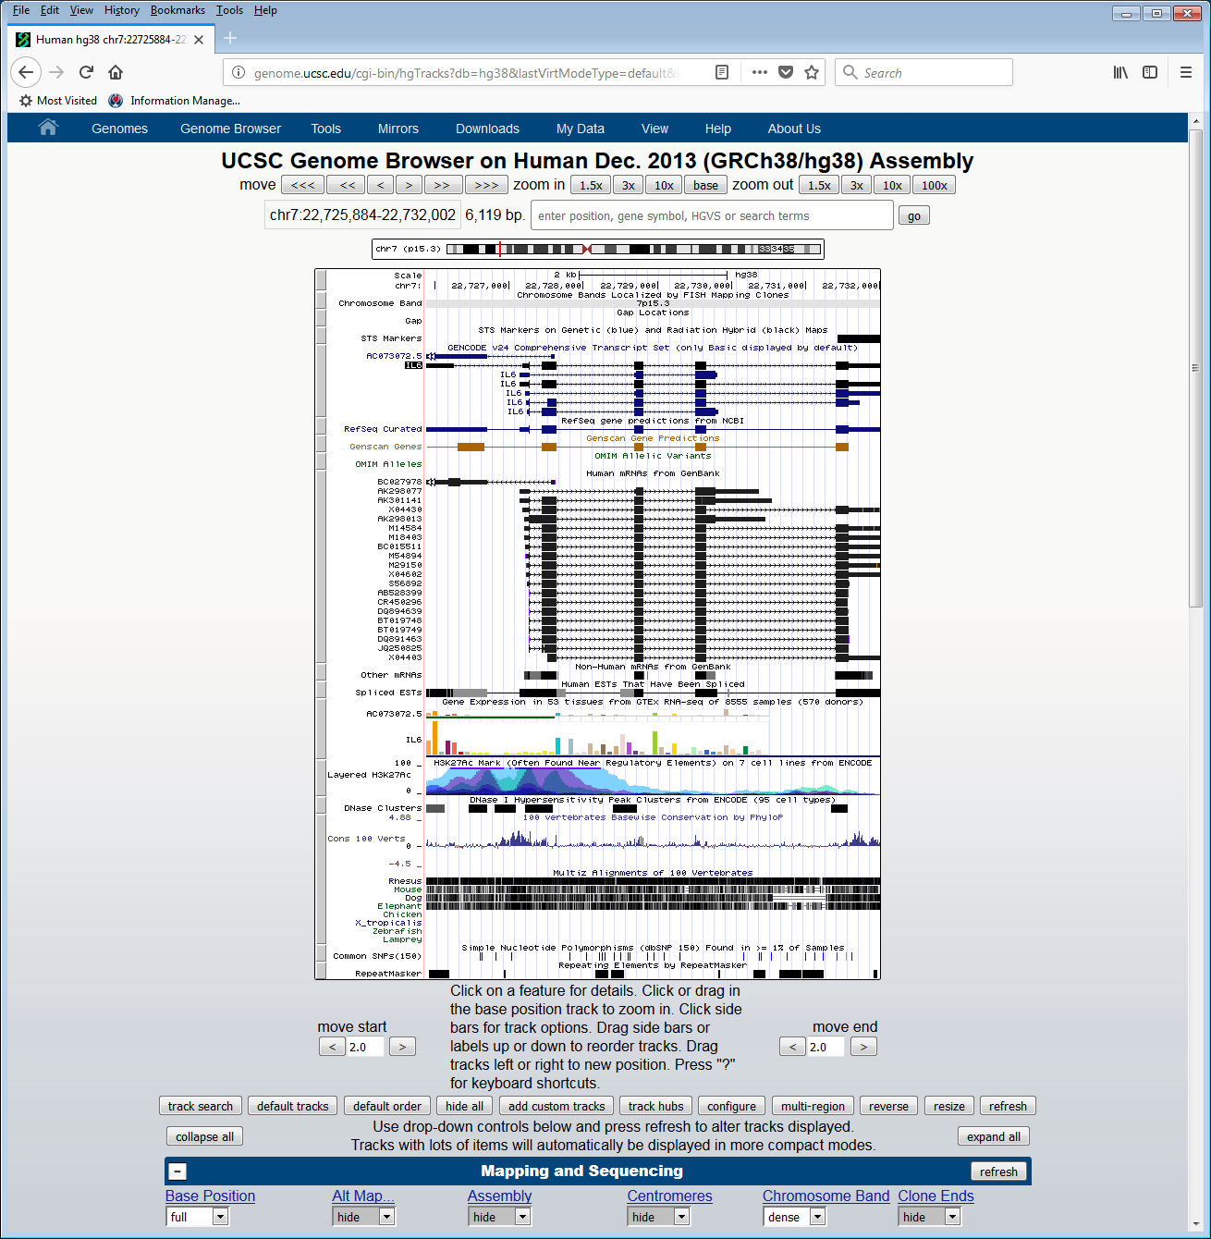
Example link to other datasets

Slide 29
Example new approaches
Took all fields from electronic health record
Coloured according to how abnormal
Used image recognition to find patterns associated with adverse outcome
Laboratory data, high frequency data
Also looked to see where the algorithm spent the most time
Laboratory data, patient vital signs

Slide 30


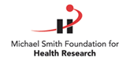
UBC co-investigators
John Boyd
Jim Russell
U Penn co-investigators
Muredach Reilly
Nuala Meyer
Jason Christie
Jane Ferguson
Databases
VASST Investigators
People
Taka Nakada
Katherine Thain
Simone Thair
Lynda Lazosky
Funding
CIHR
NIH
Keith.Walley@hli.ubc.ca

